Slide 1

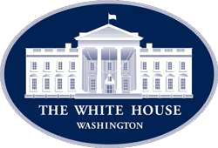

Questionary
The American History
Through its Presidents
Presentation and Comments
By Ewerson Steigleder

Slide 2
  INSTRUCTIONS TO PLAY
a) Go to Presentation Mode - NECESSARILLY
b) If you don’t, answers will show up before question
c) Use arrows to proceed and clicks when necessary
d) Pay attention in details of the questions
e) Colonies Assembly

Slide 3
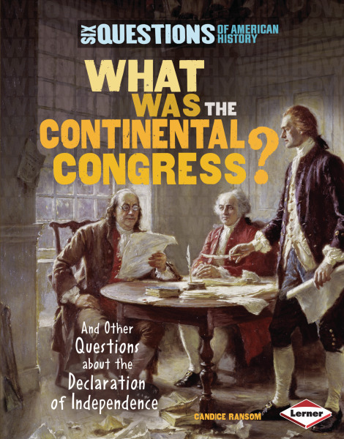
What was the name of the board who leaded the Colonies before the US Revolution?
a) America’s Assembly
b) United States Congress
c) Continental Congress
d) Constitutional Congress
e) Colonies Assembly

Slide 4
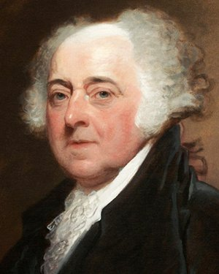
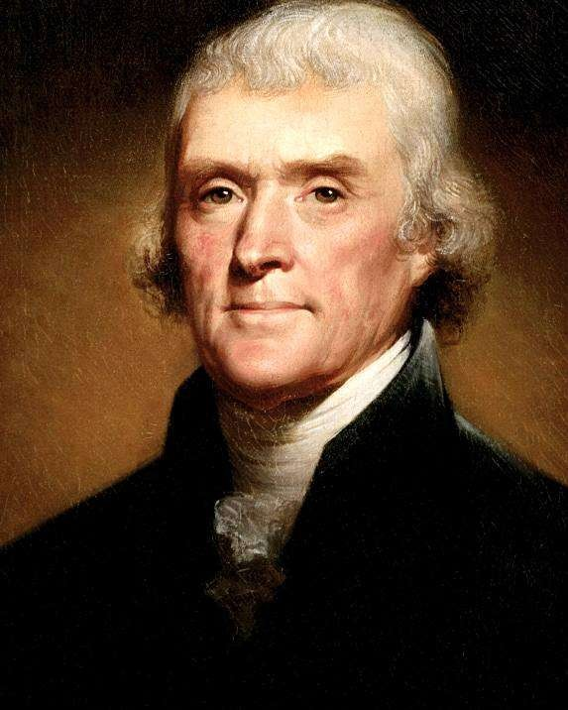
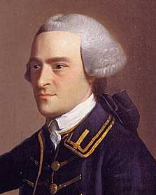
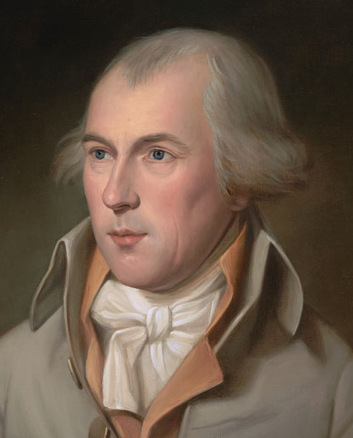
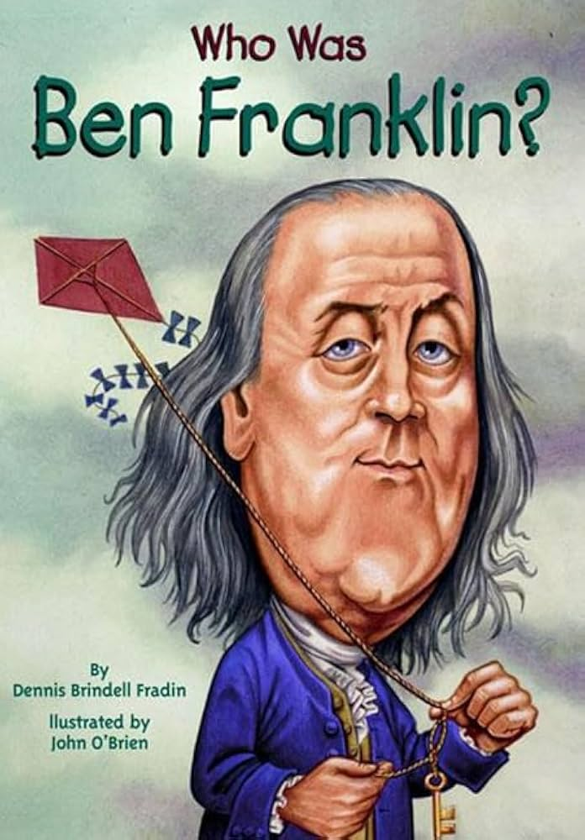

Who was the President of the US right after Ben Franklin?
Benjamin Franklin was never a US President!!
John
Adams
Thomas
Jefferson
John
Hancock
James
Madison
None
Of Them

Slide 5
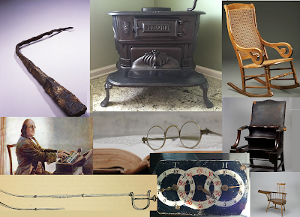
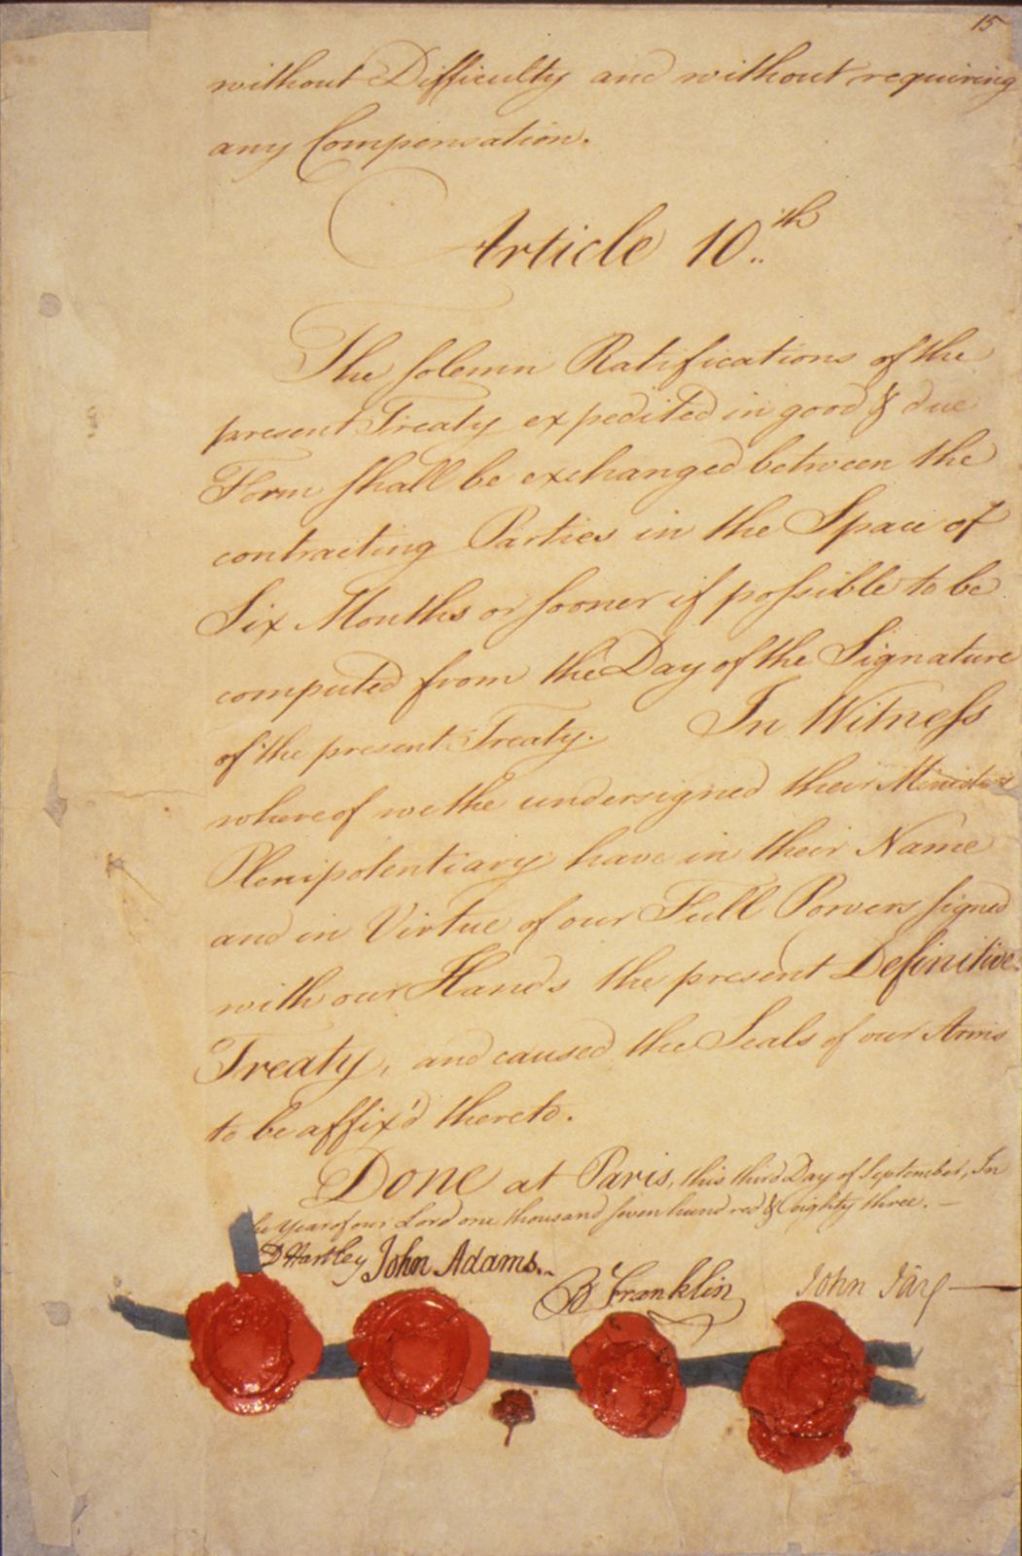
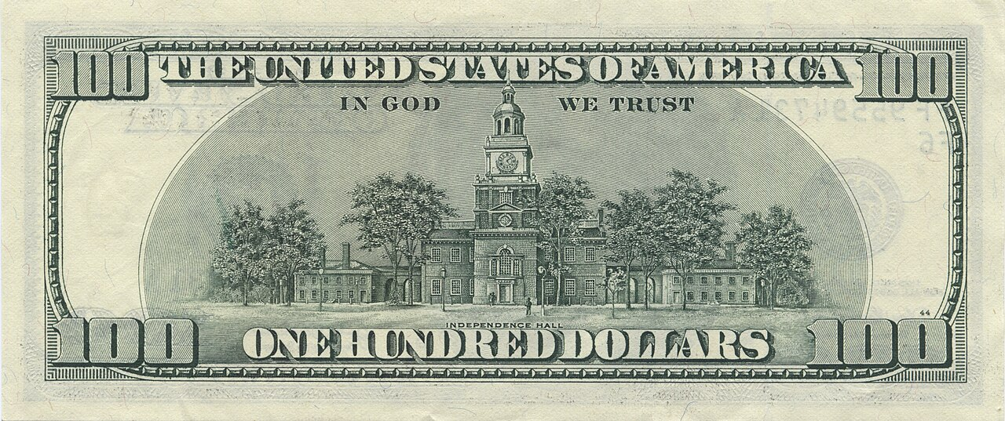
Which one of these option is not correct about Ben Franklin?
Franklin did not invent a Water Distiller…
a) Signed the 4 most important documents:
  Declaration of Independence 1776
  Treaty of Alliance with France 1778
  Treaty of Paris 1783
  US Constitution 1787
d) Figures on the hundred dollar bill
b) Invented: Franklyn Oven, Bifocal lens, Rocking chair, Water distiller.
c) Negotiated the Treaty of Parys

Slide 6
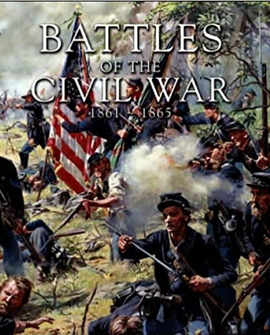

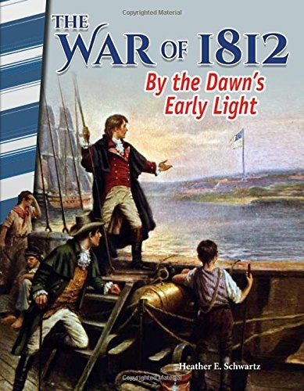
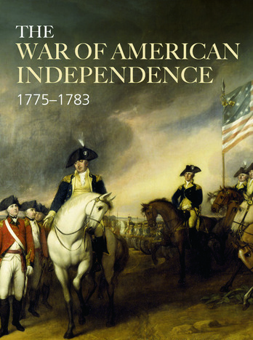
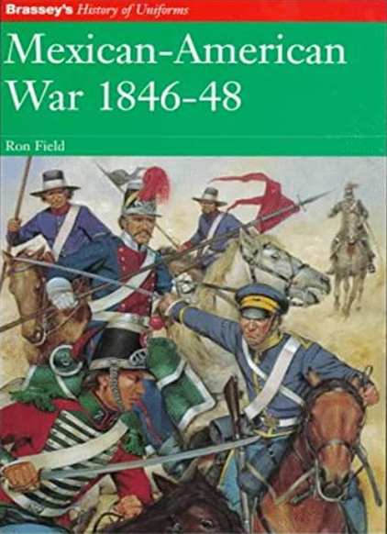
Which of this wars is known as Revolutionary War?
The Independence War is also named as:
American Revolution
Revolution War
American Independence War
1812
War
Civil
War
Independence War
Mexican
War
Great
War

Slide 7
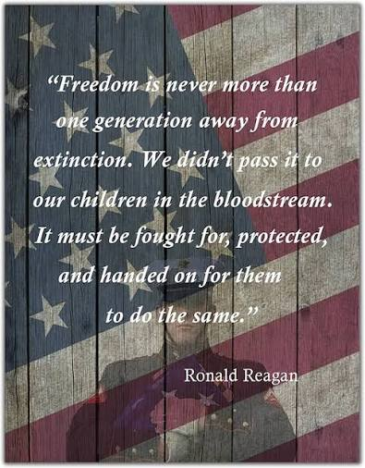
What was the spirit, the motto that brought people together to create a new world as a nation?
a) The Religion choice
b) The wish for a united nation
c) The seek for Freedom
d) The pursue of happiness
e) The exorbitant taxation

Slide 8
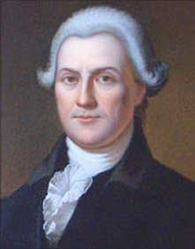
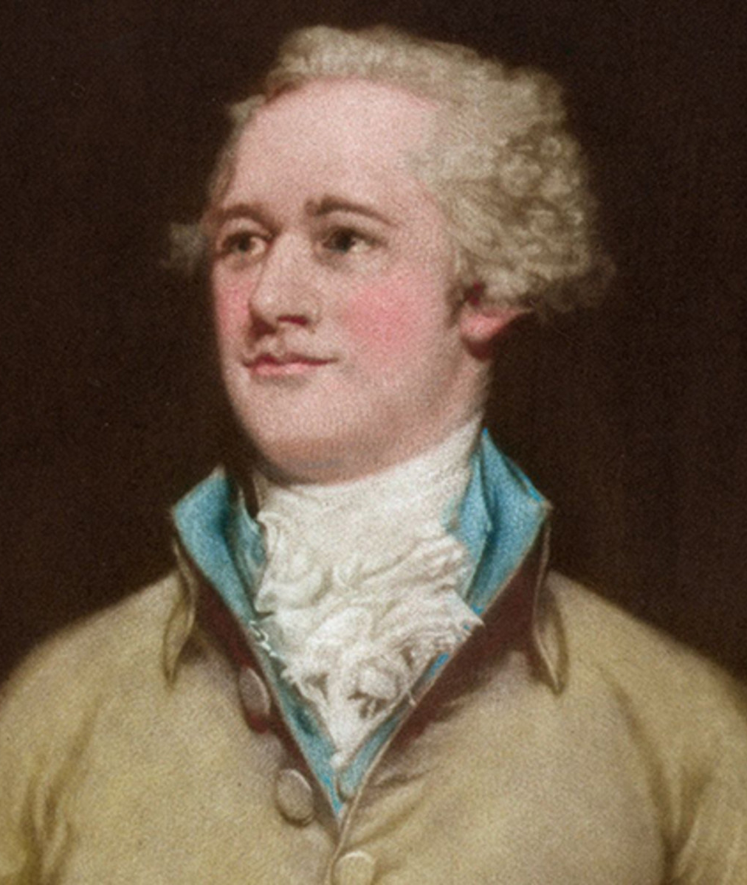
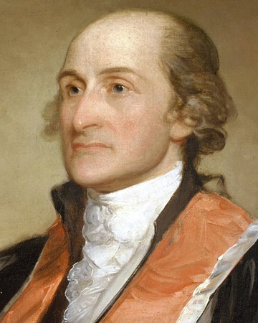
Who, among the Founding Fathers, was the first US Treasurer?
Samuel Huntington
Thomas
Jefferson
John
Hancock
Alexander
Hamilton
John
Jay

Slide 9
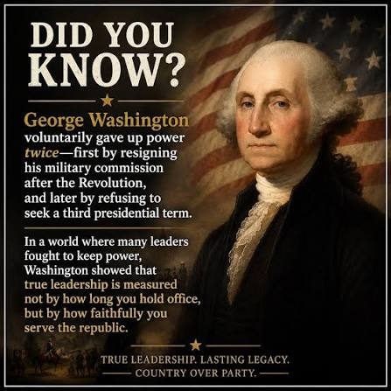
Which of the options are true about George Washington farewell?
a) He wanted to leave power after win the Revolution War
b) He wanted to leave power after his first Term as Acclaimed President
c) He left power after his second Term as US President
d) He never wanted the power
e) All of the above

Slide 10
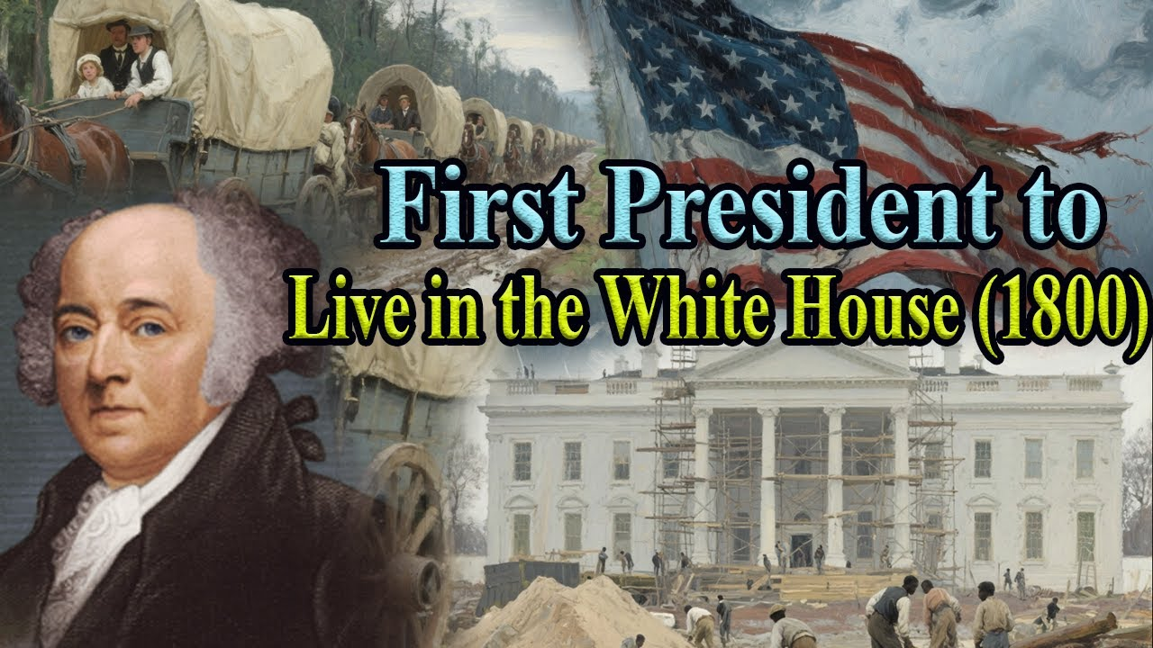
When did George Washington deliver the White House to John Adams?
a) Right at the end of the Revolutionary War
d) He has never been in the White House
b) At the end of his second Term as President
c) When the Capital was moved from NYC to DC
d) He has never been in the White House
e) When Adams was Elected

Slide 11
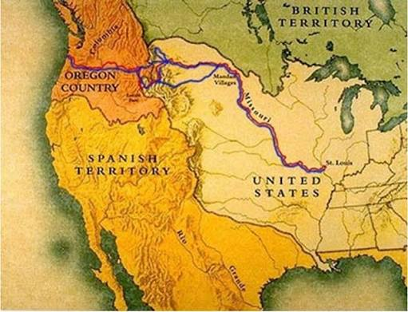
Lewis & Clark Expedition was ?
a) A British initiative to better know the new land.
b) A government plan to conquer the West.
c) A couple adventure to find a land to live.
d) A running searching for land in the West.
e) A mission to explore West after Louisiana purchase.

Slide 12
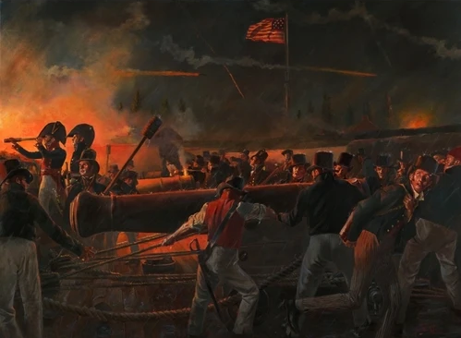
What does the Star-Spangled Banner refer to?
a) The victory over British Empire in War of 1812.
d) The flag flying over Fort McHenry during a battle.
b) The “land of a free and home of the brave”.
c) The braves who brought stripes and bright stars to the fight
d) The flag flying over Fort McHenry during a battle.
e) The prove that soldiers were alive

Slide 13
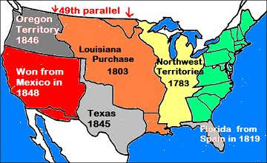
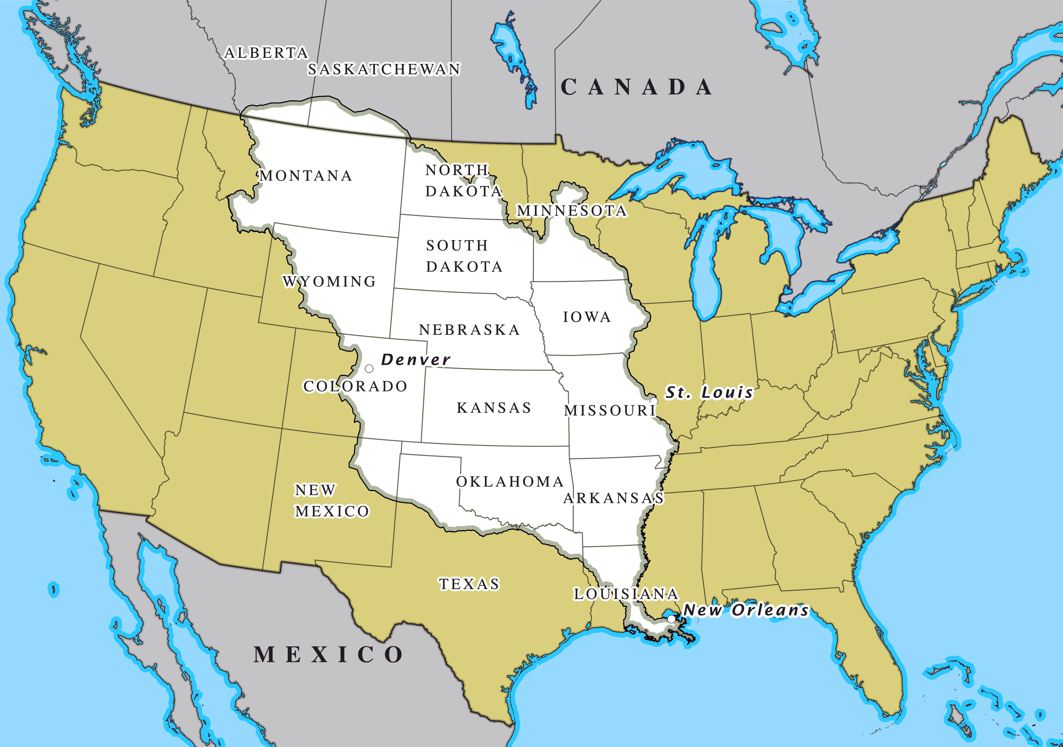
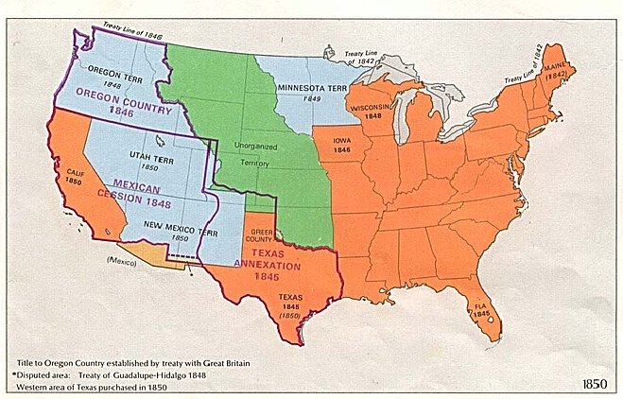
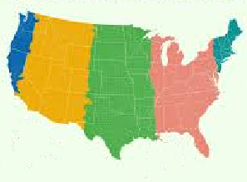
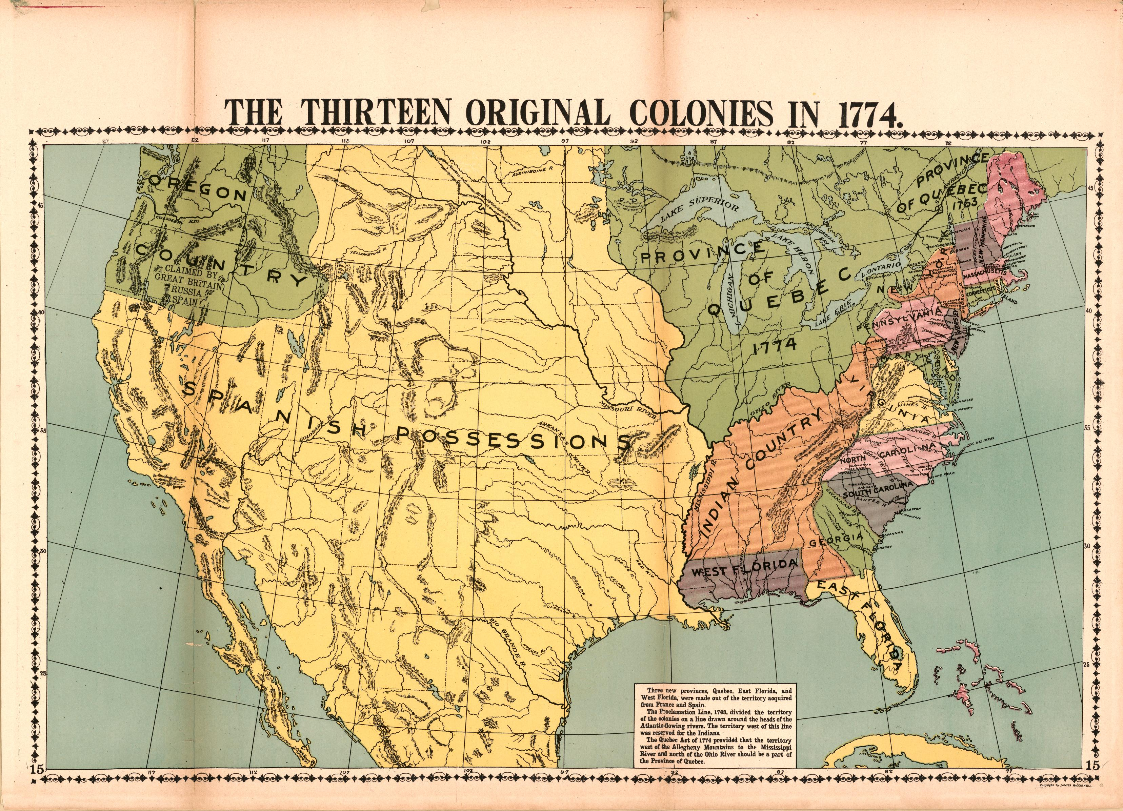
Which map better illustrates the expansion of the United States?
b)
a)
c)
e)
b)
d)

Slide 14
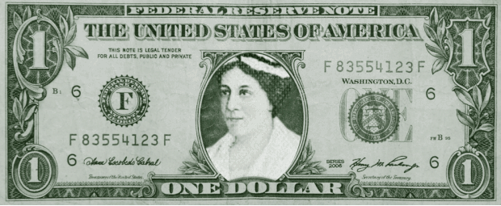
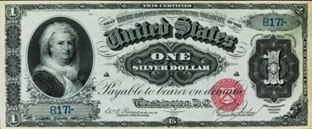
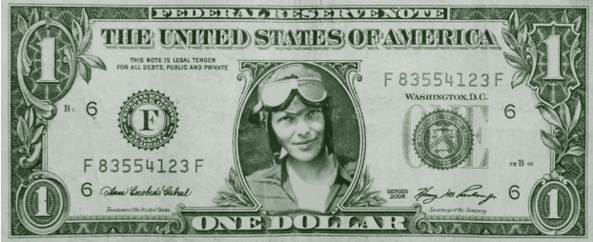
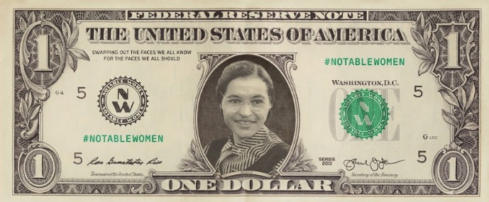
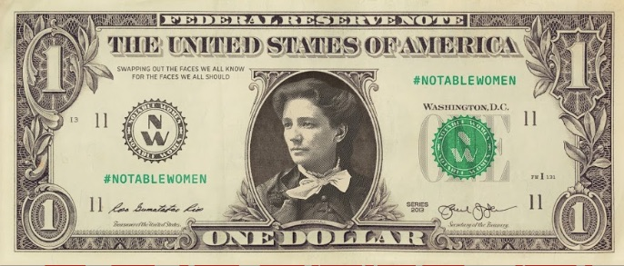
Who was the first woman to figure in a dollar bill?
c) Betsy Ross
d) Martha Washington
a) Rosa Parks
e) Amelia Earhart,
b) Victoria Woodhull
d) Martha Washington
Notes:
a) Rosa Parks (1913–2005) was an American civil rights activist, She refuses to give up her seat on a segregated bus in Montgomery, Alabama, on December 1, 1955
b) Victoria Woodhull (1838–1927) was an American activist, writer, publisher, financial entrepreneur, and the first woman to run for President of the United States.
c) Betsy Ross (1752–1836) was an American a seamstress who is credited for making the first US flag with 13 stars and 13 stripes during the American Revolution.
d) Martha Washington (1731–1802) was George Washington’s wife, the US first President, and is remembered as the first First Lady of the United States.
e) Amelia Earhart (1897–1937) was an American aviation pioneer, the first woman to fly solo across the Atlantic Ocean.

Slide 15
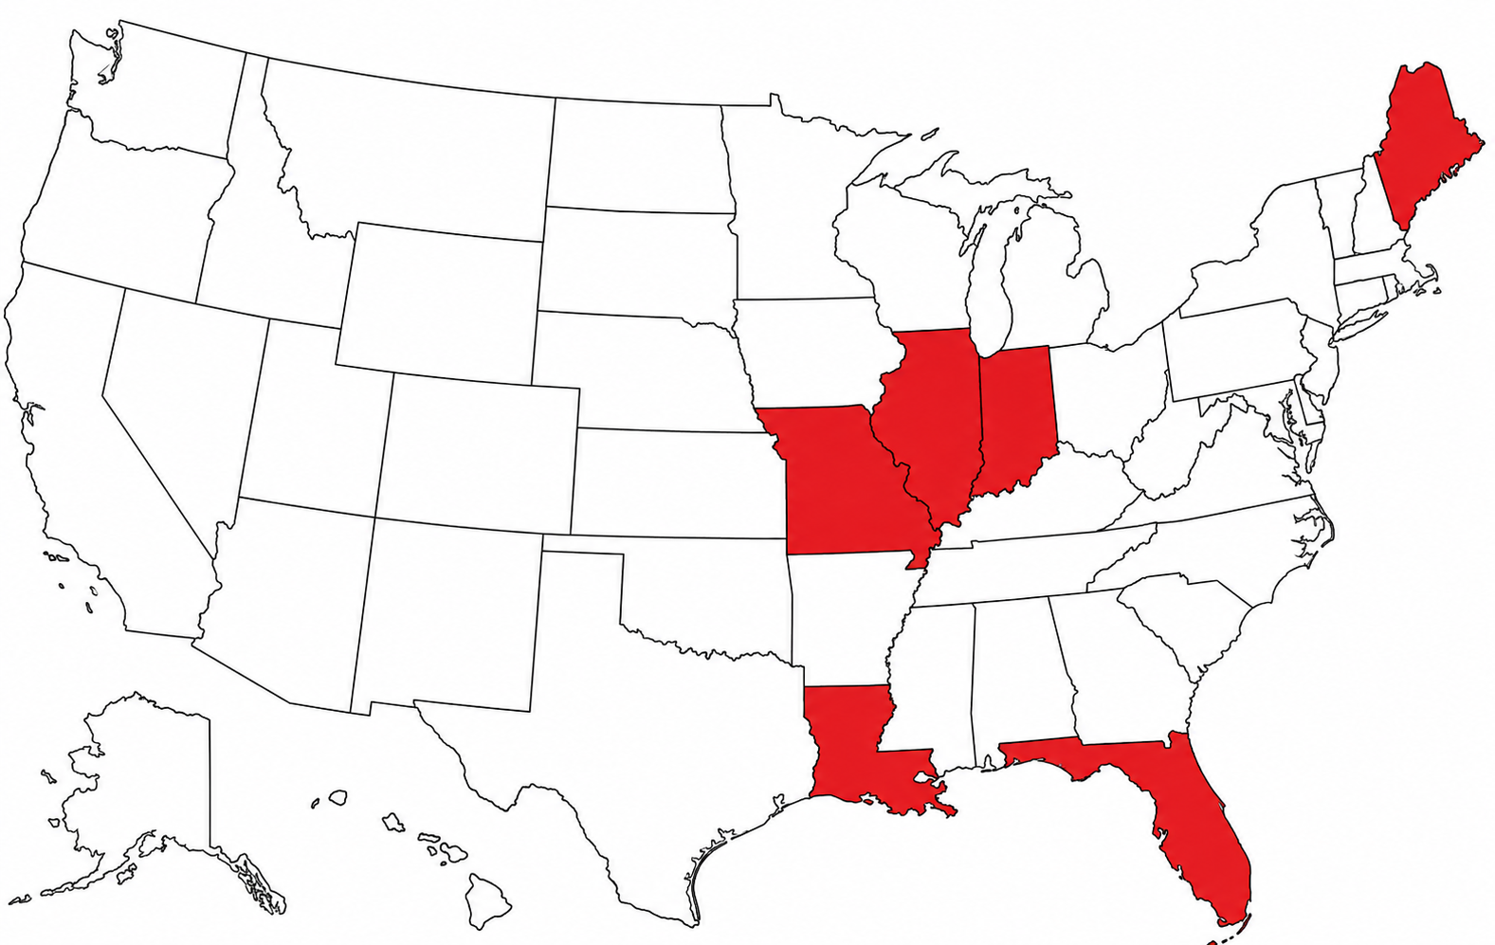
James Monroe had an important role in which expansion processes?
a) Texas Annexation and Florida Purchase
b) Louisiana and Florida Purchase
c) Oregon Negotiation and California Purchase
d) Missouri, Illinois, Indiana and Maine Purchase
e) Florida, Mississippi and Alabama Purchase
1) a/d
2) b/e
3) a/b
4) d/e
5) b/c

Slide 16
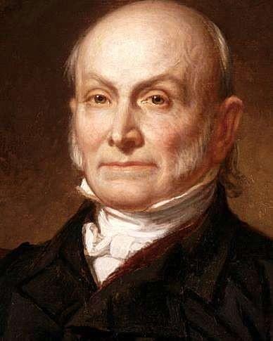
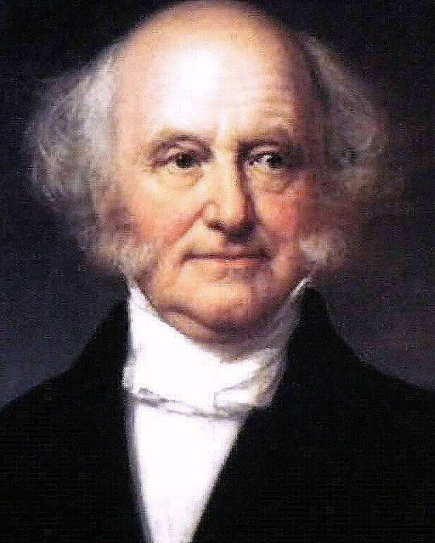
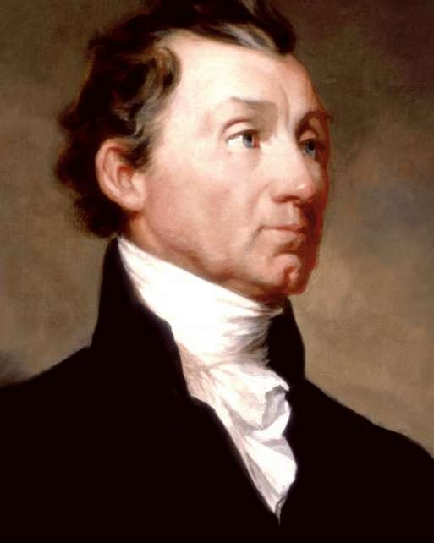
Who was the first US-born President of the United States?
Born: December 5, 1782, Kinderhook, New York
Why significant: He was the first president born after the Declaration of Independence (1776).
The seven presidents before him were born as British subjects in the American colonies.
John Quincy
Adams
Thomas
Jefferson
Martin
Van Buren
James
Madison
James Monroe

Slide 17
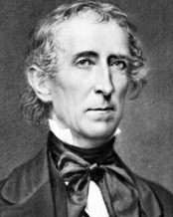
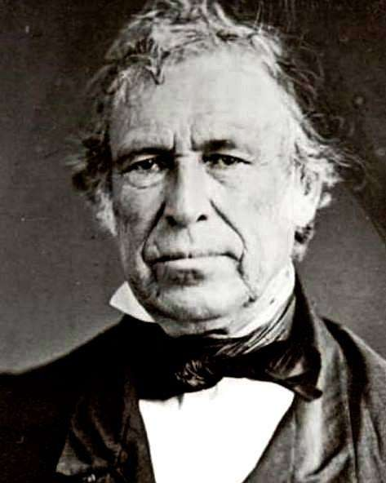
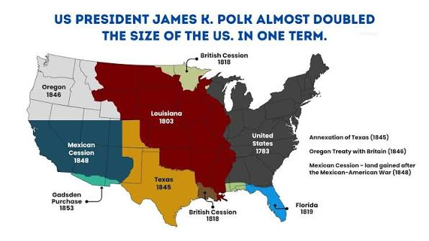
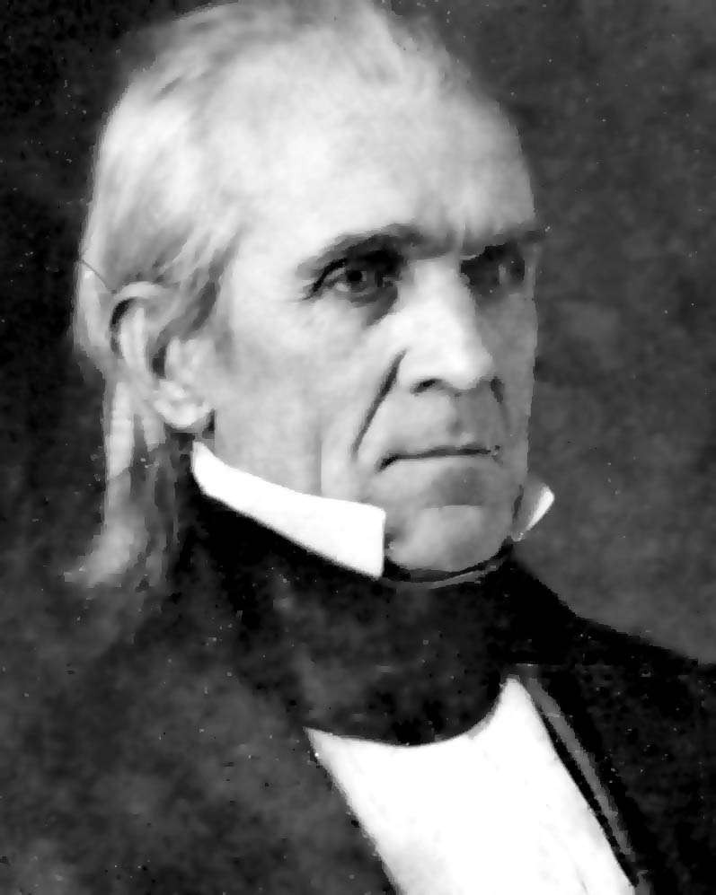
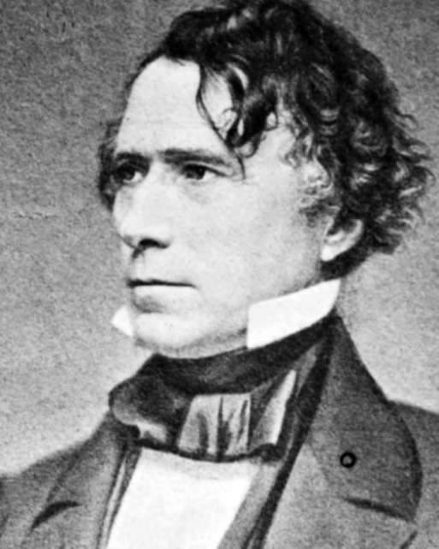
Which U.S. president completed the formation of the continental part of the United States as it is today?
John
Tyler
James K.
Polk
Zachary
Taylor
Franklin
Pierce
James Monroe

Slide 18
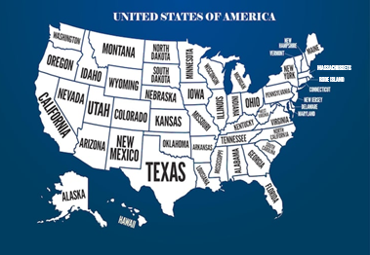
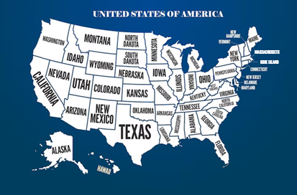
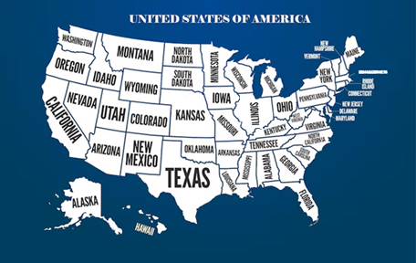
Which map is the correct division of actual States of the United States?
b)
a)
c)
c)

Slide 19
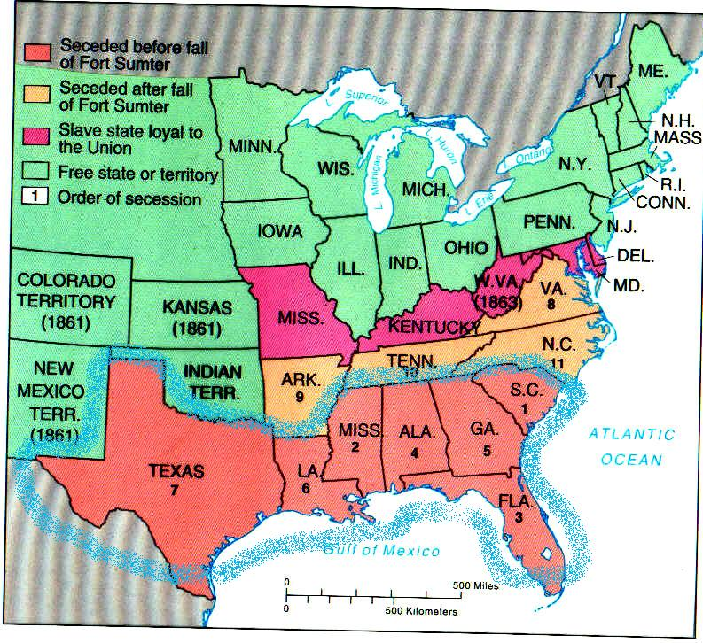
By the end of 1861, how many states had seceded from the Union?
a) 7 states: FL, GA, AL, MS, LA, SC, TX.
7 states: FL, GA,
AL, MS, LA, SC, TX.
b) 9 states: FL, GA, AL, MS, LA, TX, SC, NO, AR.
c) 11 states: TX,LA,MS,AR,TN,AL,GA,SC,NC,FL,VA.
d) 15 states: TX,LA,MS,AR,TN,AL,GA,SC,NC,FL,VA,MS,KY,WV,MD.
e) 19 states: TX,LA,MS,AR,TN,AL,GA,SC,NC,
FL,VA,MS,KY,WV,DE,MD,IN,IL,OH.

Slide 20
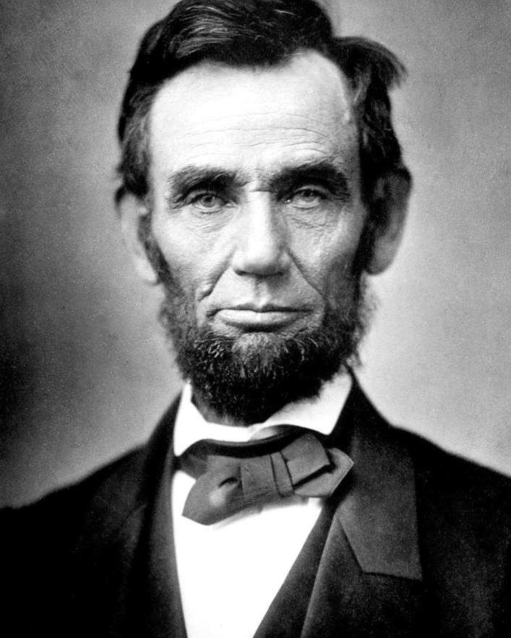
Which phrase became famous worldwide after the American Civil War?
a) “In God we Trust”
b) “No taxation without representation”
c) “The shot heard ’round the world”
d) “Government of the people,
by the people, for the people”
e) “All men are created equal”

Slide 21
Why did President Ulysses S. Grant have no vice president from 1875 to 1877?
a) Because Grant said he would not support Henry Wilson’s candidacy to succeed him, and Wilson resigned from office.
b) Because Vice President Henry Wilson died in 1875, and the Constitution did not allow a replacement.

Slide 22
Match the phrase with its author:
“Keep your eyes on the stars, and
your feet on the ground.”
“The only thing we have to fear
is fear itself.”
1) John F. Kennedy
“Ask not what your country can do for you
ask what you can do for your country.”
2) Donald J. Trump
3) Ronald Reagan
“Government Of the people,
By the people, For the people”
4) George W. Bush
e) “open this gate, tear down this wall!”
5) Theodore Rosevelt
f) “I will Make America Great Again!”
6) Franklin D. Rosevelt
“I can hear you! The rest of the world (…) will hear from you soon!”
7) Abraham Lincoln
Notes:
If you clique the First name, it will show the correct answer. So, try to respond before to get the answer.

Slide 23

What US Presidents have been assassinated?
a) Lincoln-Garfield-Kennedy
b) Lincon-Garfield-Hayes-Harrison-Kennedy
c) Lincon-Garfield-McKinley-Hayes-Harrison-Kennedy
d) Lincon-Garfield-McKinley-Kennedy
e) Lincoln-Madison-Garfield-Harrison-Kennedy

Slide 24
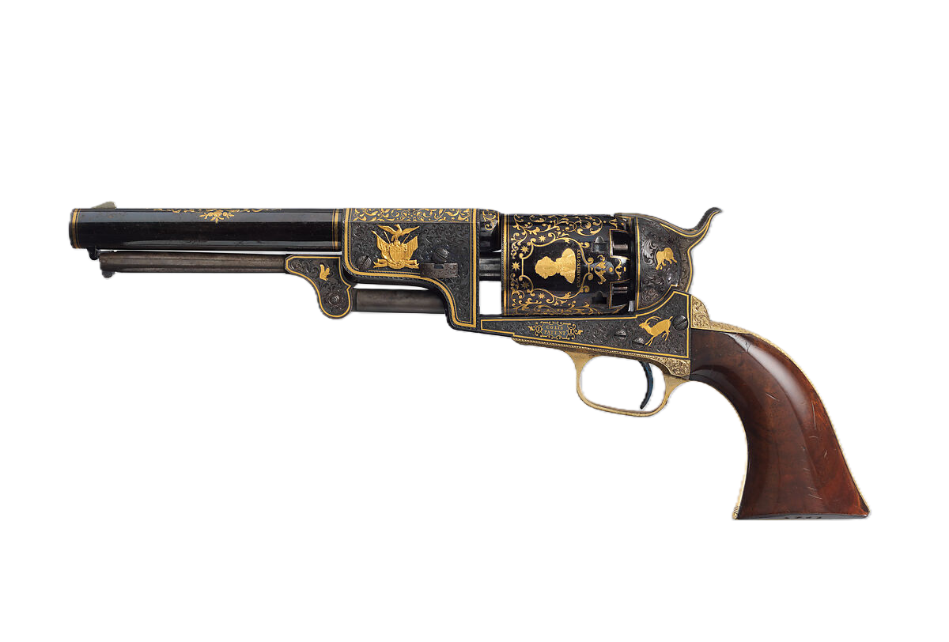
How many and who were the US Presidents that were shut/wounded by a gunfire?
a) 4: Lincon-Garfield-Reagan-Kennedy
b) 5: Lincoln-Garfield-Reagan-Kennedy-Trump
c) 6: Lincon-Garfield-Reagan-Harrison-Teddy-Kennedy
d) 7: Lincon-Garfield-McKinley-Teddy-Kennedy-Reagan-Trump
e) 8: Abbe-Garfield-Harrison-Teddy-JFK-Bobby-Reagan-Trump

Slide 25
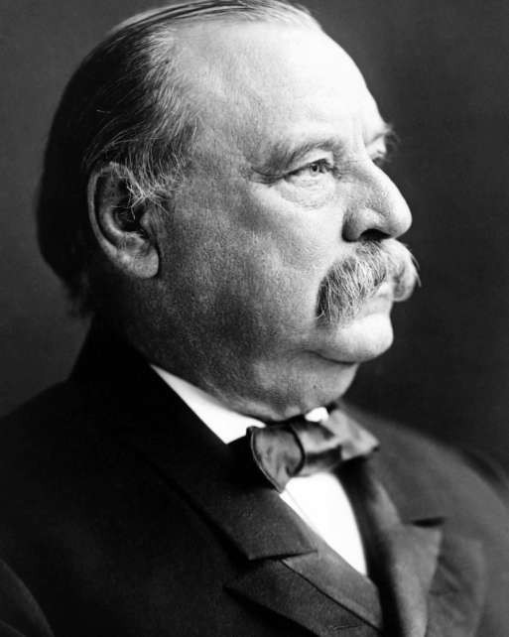
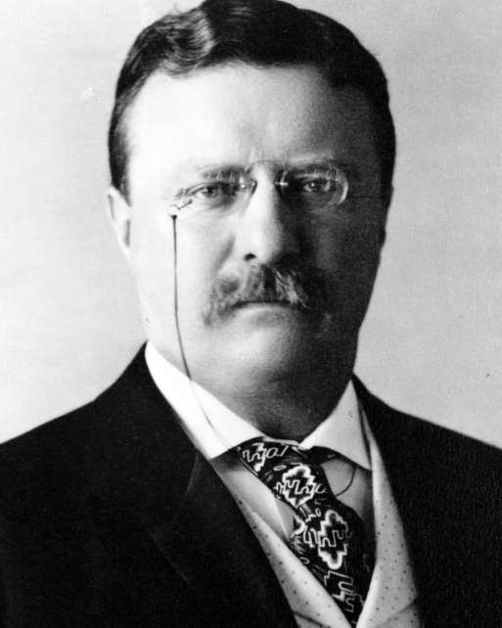
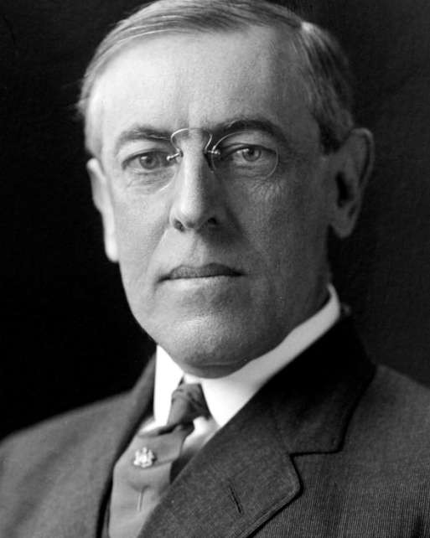


In which mandate passed the 18th and 19th Amendments – Prohibition and Women’s Vote?
Wilson vetoed the Prohibition, but Congress overrode the veto.
Grover
Cleveland
Theodore
Rosevelt
William H.
Taft
Woodrow
Wilson
Herbert C. Hoover

Slide 26






How many U.S. Presidents have died while in office?
a) 4
b) 5
c) 6
d) 7
e) 8
Notes:
William Henry Harrison — 1841 — doença
Zachary Taylor — 1850 — doença
Abraham Lincoln — 1865 — assassinado
James A. Garfield — 1881 — assassinado
William McKinley — 1901 — assassinado
Warren G. Harding — 1923 — doença
Franklin D. Roosevelt — 1945 — doença
John F. Kennedy — 1963 — assassinado

Slide 27
Which U.S. presidents have appeared on dollar bills and/or certificates throughout U.S. history?
1) George Washington
$1
6) James Monroe
$100
2) Thomas Jefferson
$2
7) William McKinley
$500
3) Abraham Lincoln
$5
8) Grover Cleveland
$1000
4) Andrew Jackson
$20
9) James Madison
$5000
5) Ulysses S. Grant
$50
10) Woodrow Wilson
$100.000

Slide 28










Which U.S. presidents figure nowadays on the regular coins in the USA?
1) Abraham Lincoln - Penny
2) Thomas Jefferson - Nickel
3) Franklin D. Rosevelt - Dime
4) George Washington - Quarter
5) John F. Kennedy - Half Dollar
Notes:
Lincoln – Penny 1 cent
Jefferson – Nickel – 5 cents
FDR – Dime – 10 cents
Washington – Quarter 25 cents
JFK – Half Dollar – 50 cents (difficult to find)
$1 coin – Eisenhower, James Monroe, Franklin Pierce and others
COMMUN – Word LIBERTY and GOD

Slide 29

Witch of these statements about FDR is not true?
a) Fifth cousin of Teddy Rosevelt
b) Won 4 times the presidential election
c) Order the nuclear attack, but died before to see it
d) In 1921 had Polio when he was 39 years old
e) Faced the Great Depression through the New Deal

Slide 30



Which U.S. presidents have been impeached by the House of Representatives?
a) Trump, Clinton and Nixon
b) Trump, Clinton, Nixon, and A. Johnson
c) Trump, Clinton and A. Johnson
d) Trump, Nixon and A. Johnson
e) Trump and Clinton
Notes:
Trump twice 2019/2021
Clinton 2 articles – For lying under oath before Grand Jury and Obstruction of Justice
Johnson 11 articles – Tenure Office Act – Official approved by Congress needs Congress approval to be fired

Slide 31

Who was the U.S. president that was never elected?
a) Jimmy Carter
b) Dwight Eisenhower
c) Lyndon Johnson
d) Harry S. Truman
e) Gerald R. Ford
Notes:
He was chosen by Nixon when his vice Spiro Agnew resigned in 1973 (bribery, extortion and tax evasion when Governor)
Then, assumed the presidency when Nixon resigned, in 1974 and finished his mandate.
He ran for reelection but lost to Jimmy Carter.

Slide 32

Based on the American perspective, Cold War was a global struggle for power and influence seeking for what?
a) Supremacy and control of Oil around the globe
b) Territorial expansion in the occident and orient
c) Financial power in world trades
d) Defense of democracy, liberty, capitalism, property
e) Accomplish the American Dream

Slide 33

Match the War with who ended it:
1) Richard Nixon
COLD WAR
2) Dwight Eisenhower
VIETANM WAR
3) Ronald Reagan
WORLD WAR II
4) George W. Bush
GREAT WAR
5) Harry S. Truman
e) DESERT STORM
6) George H. W. Bush
f) CIVIL WAR
7) Abraham Lincoln
KOREAN WAR
8) Woodrow Wilson
h) IRAQ WAR
Notes:
If you clique the First name, it will show the correct answer. So, try to respond before to get the answer.

Slide 34

What wars did President Trump ended?
1)
Thailand vs Cambodia
2)
Servia vs Kosovo
3)
Rwanda vs Congo
4)
India vs Pakistan
5)
Israel vs Hamas
6)
Egypt vs Ethiopia
7)
Armenia vs Azerbaijan
Notes:
When you click on the numbers, the answer will showup
Struggling in ending
USA vs Iran
Israel vs Iran
Ukraine vs Russia
Theoretically Cuba is about to end

Slide 35


Which statement is the most correct one? - The USA is:
a) Conservative, Protestant, Libertarian
b) Progressive, Libertarian, Protestant
c) Catholic, Liberal, Conservative, Democratic
d) Conservative, Democratic, Protestant, Capitalist
e) Progressive, Catholic, Capitalist, Democratic
Notes:
É o mesmo livro em Inglês e Português
As teorias de Max Weber são profundas quanto ao Protestantismo (Calvinista) e o Capitalismo, muito ilustradas no livro.
O Conservadorismo no entanto, já seria traduzido da questão Ética, família, ordem, diciplina, mas não diretamente tratado nste livro.
A Democracia neste livro especificamente já é o ponto mais forte, mas no context de responsabilidade individual, participação cívica e autonomia pessoal seriam pilares basilares da Democracia.

Slide 36

The American Way of Life, is based in 3 unalienable Rights, which are:
a) Freedom, Equality and Justice
b) Life, Liberty and the Pursuit of Happiness
b) Life, Liberty and the Pursuit of Happiness
c) Life, Property and Individual Freedom
d) Liberty, Democracy and Equal Opportunities
e) Religion Freedom, Free Speech and Private Property
Notes:
Expressed on the DI.
Jefferson was strongly influenced by John Lock, who advocate for Liberty, Property and pursuit of Happiness, but the idea that was presented in the DI was: Life, Liberty and Pursuit of Happiness as rights gave to us by God.

Slide 37
Match Names and Last Names:
1) John
HAYES
2) Zachary
JACKSON
3) Andrew
ARTHUR
4) Millard
d) HARDING
5) Rutherford B.
e) TAFT
6) James
f) COOLIDGE
7) Warren G.
TAYLOR
8) Martin
h) BUCHANAN
9) Chester
i ) TYLER
10) Calvin
j ) VAN BUREN
11) William H.
k) FILLMORE
Notes:
If you clique the First name, it will show the correct answer. So, try to respond before to get the answer.

